Slide 1


Supply chain and Ecommerce KPIS

Slide 2


Data description
The data divided into 5 files:
Customers
Orders
Ordered items
Payments
Products

Slide 3

Customers
Description: Contain about the customers who have placed orders
customer_id
customer_zip_
code_prefix
customer_city
customer_state

Slide 4

Ordered Items
Description : contain information about the ordered Items during the given period
order_id
product_id
seller_id
price shipping_charges

Slide 5

Orders
Description: the Fact table and contain the data about the orders in the given period
order_id
customer_id
order_purchase_timestamp
order_approved_at

Slide 6

Payments
Description: contain the data anout the payment method and timing during the given period
order_id
payment_sequential
payment_type
payment_installments
payment_value

Slide 7
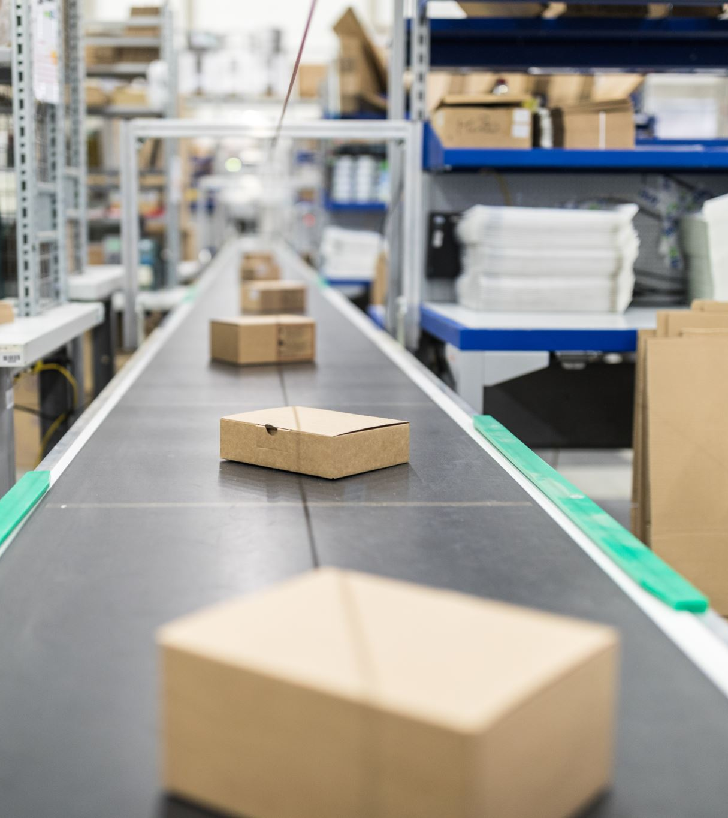
Products
Description: contain the data about all the products that was in the inventory during the given time
product_id
product_category_name
product_weight_g
product_length_cm
product_height_cm
product_width_cm

Slide 8
Needed KPIs

Slide 9
Customer KPIs:
Customer Lifetime Value (CLTV): Prediction of the total value a customer brings over their lifetime.
Customer Acquisition Cost (CAC): Cost of acquiring a new customer.
Customer Retention Rate: Percentage of returning customers versus new customers.
Churn Rate: The percentage of customers who stop purchasing after a certain period.

Slide 10

Sales KPIs:
Total Revenue: Sum of all sales revenue.
Average Order Value (AOV): Total revenue divided by the number of orders.
Sales by Product Category: Revenue generated by each product category.
Sales Growth Rate: The percentage increase or decrease in sales over a specific period.

Slide 11
Order KPIs:
Order Fulfillment Time: Average time taken from order placement to delivery.
Order Return Rate: Percentage of orders returned by customers.
Order Conversion Rate: Percentage of visitors who place an order.

Slide 12
Product KPIs
Best-Selling Products: Products with the highest sales.
Inventory Turnover Rate: How quickly inventory is sold and replaced.
Stock-Out Rate: Percentage of items out of stock.

Slide 13
Operational KPIs:
Shipping Cost Per Order: Average shipping cost incurred per order.
On-Time Delivery Rate: Percentage of orders delivered on or before the expected date.
Cancellation Rate: Percentage of orders canceled by customers.

Slide 14
Financial KPIs:
Gross Margin: Revenue minus the cost of goods sold (COGS).
Net Profit Margin: Net profit divided by revenue.

Slide 15
Thank you

